Slide 1
Virtual Open House
Thursday, August 13, 2020
Dr. Jocelyn Lakani-Jones, Principal
Dr. Clifton Nicholson, Assistant Principal
Ms. Asha Thompson, Assistant Principal

Slide 2
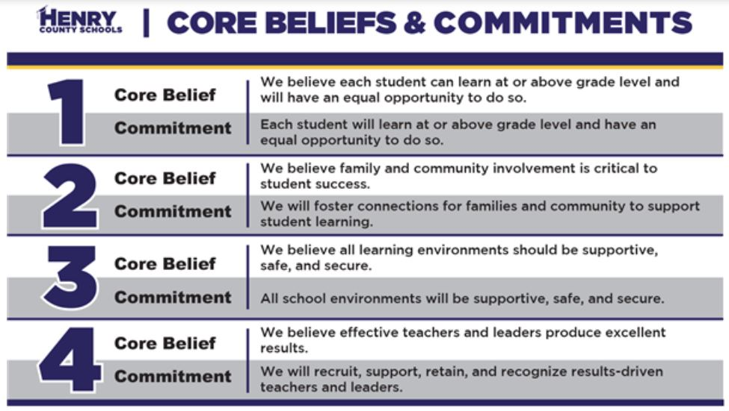
Core Beliefs

Slide 3
Google Meet Resources
Google Chrome Store Resources for Download https://chrome.google.com/webstore/category/for_your_domain
Classlink OneClick Extension- This extension empowers the students and teachers with instant access to their learning resources such as Google Meet, Google Classroom, Discovery Education, HMH Resources, and Mind Play to name a few.
Kami Extension- This extension allows the students to complete assignments via Google Classroom using a full array of Kami tools. Kami essentially becomes a whiteboard overlay during the lesson as well. It reduces/ eliminates the need for classroom printing and has tools that support ECE students. Teachers can add highlighting/ notes to customize per each student if needed.
Meet Attendance- This extension allows the teacher to log the attendance of whom is present and accounted for the virtual learning day
Nod- This extension allows a muted student respond to teacher without interrupting the lesson. The student can raise their hand or display thumbs up or down and even laugh at a joke so students can be expressive without words.
Google Meet Gridview- This extension allows the students to view all classmates in a grid. This is advantageous for the the teacher to view all their students and the students can socialize with classmates at recess.

Slide 4
Remote Learning Behaviors for Students
Log on by 7:45am (attendance taken daily)
Mute your computer (unless teacher tells you to unmute)
Be presentable
Raise hand using Nod
Use chat box to ask questions/comments
Positive comments only
Be a active participant/listener
Must stay on the entire class
Technical problem-contact teacher immediately
Complete classwork or workbook by due date in Google Classroom
Small Group
Can ask for help until 3:30 via Google Meet/email/Class Dojo/telephone
Monitor through GoGuardian
Students are asked to wear headphones during assessments, to limit distractions.

Slide 5
Role of the Remote Parent
Help your child be ready to learn by 7:45 am.
Read Google Classroom Stream daily for updates.
Reach out to teacher for help with submitting assignments, concerns, technical problems, or questions.
Ensure your child completes assignments in Google Classroom or workbooks.
If available, stay present during lessons.

Slide 6
Remote Learning (Co-Teaching)
Both teachers are present and active
One teach, one monitor
Collaboration (Will meet twice a week to discuss lessons, preparations, and provided feedback)
Parent Communication:
student progress
completion of assignments
questions/concerns
Google Meet IEP meetings/ESOL/Gifted

Slide 7
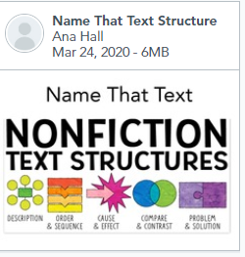
Lesson Platforms for Reading and Social Studies
ActivInspire/Openboard
Anchor Charts
Flipgrid
Quizizz
Youtube
Flocabulary- Read and Response
Accelerated Reader
Nearpod
EReading
Discovery Education
GCEE-Georgia Council for Economic Education
Smart Path
HMH

Slide 8
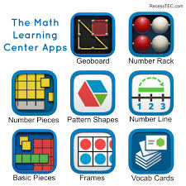
Lesson Platforms for Math and Science
HMH Resources (Math, Science, & SS)
Math Learning Center Apps
Math Jeopardy
Odysseyware
YOUTUBE

Slide 9
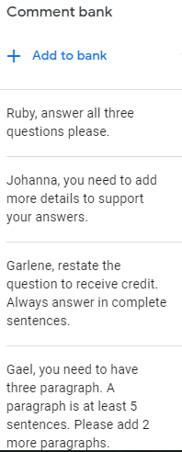
Feedback on Assignments
Provide feedback on Google Classroom assignments using the add comments tab in Google Docs or using Kami.
Allow students to resubmit work after providing feedback.

